Slide 1
CSE214 – Analysis of Algorithms PhD Furkan Gözükara, Toros University https://github.com/FurkanGozukara/Analysis-of-Algorithms-2019
Lecture 5
Quicksort
Based on Kruse’s and Ryba’s Lecture Notes

Slide 2
Sorting algorithms
Insertion, selection and bubble sort have quadratic worst-case performance
The faster comparison based algorithm ?
O(nlogn)
Mergesort and Quicksort
Notes:
Quadratic 2. dereceden kareli

Slide 3
Quicksort Algorithm
Fastest known sorting algorithm in practice
Caveats: not stable,
Vulnerable to certain attacks
Average case complexity →O(N log N )
Worst-case complexity → O(N²)
Rarely happens, if coded correctly
Notes:
Caveats sakınsın şerh dikkatli ol ihtar ikaz

Slide 4
Quicksort Algorithm
Given an array of n elements (e.g., integers):
If array only contains one element, return
Else
pick one element to use as pivot.
Partition elements into two sub-arrays:
Elements less than or equal to pivot
Elements greater than pivot
Quicksort two sub-arrays
Return results

Slide 5
Example
We are given array of n integers to sort:
40
20
10
80
60
50
7
30
100

Slide 6
Pick Pivot Element
There are a number of ways to pick the pivot element. In this example, we will use the first element in the array:
40
20
10
80
60
50
7
30
100

Slide 7
Partitioning Array
Given a pivot, partition the elements of the array such that the resulting array consists of:
One sub-array that contains elements >= pivot
Another sub-array that contains elements < pivot
The sub-arrays are stored in the original data array.
Partitioning loops through, swapping elements below/above pivot.

Slide 8
pivot_index = 0
40
20
10
80
60
50
7
30
100
[0] [1] [2] [3] [4] [5] [6] [7] [8]
too_big_index
too_small_index

Slide 9
While data[too_big_index] <= data[pivot]
++too_big_index
pivot_index = 0
40
20
10
80
60
50
7
30
100
[0] [1] [2] [3] [4] [5] [6] [7] [8]
too_big_index
too_small_index

Slide 10
While data[too_big_index] <= data[pivot]
++too_big_index
pivot_index = 0
40
20
10
80
60
50
7
30
100
[0] [1] [2] [3] [4] [5] [6] [7] [8]
too_big_index
too_small_index

Slide 11
While data[too_big_index] <= data[pivot]
++too_big_index
pivot_index = 0
40
20
10
80
60
50
7
30
100
[0] [1] [2] [3] [4] [5] [6] [7] [8]
too_big_index
too_small_index

Slide 12
While data[too_big_index] <= data[pivot]
++too_big_index
While data[too_small_index] > data[pivot]
--too_small_index
pivot_index = 0
40
20
10
80
60
50
7
30
100
[0] [1] [2] [3] [4] [5] [6] [7] [8]
too_big_index
too_small_index

Slide 13
While data[too_big_index] <= data[pivot]
++too_big_index
While data[too_small_index] > data[pivot]
--too_small_index
pivot_index = 0
40
20
10
80
60
50
7
30
100
[0] [1] [2] [3] [4] [5] [6] [7] [8]
too_big_index
too_small_index

Slide 14
While data[too_big_index] <= data[pivot]
++too_big_index
While data[too_small_index] > data[pivot]
--too_small_index
too_big_index < too_small_index
swap data[too_big_index] and data[too_small_index]
pivot_index = 0
40
20
10
80
60
50
7
30
100
[0] [1] [2] [3] [4] [5] [6] [7] [8]
too_big_index
too_small_index

Slide 15
While data[too_big_index] <= data[pivot]
++too_big_index
While data[too_small_index] > data[pivot]
--too_small_index
If too_big_index < too_small_index
swap data[too_big_index] and data[too_small_index]
pivot_index = 0
40
20
10
30
60
50
7
80
100
[0] [1] [2] [3] [4] [5] [6] [7] [8]
too_big_index
too_small_index

Slide 16
While data[too_big_index] <= data[pivot]
++too_big_index
While data[too_small_index] > data[pivot]
--too_small_index
If too_big_index < too_small_index
swap data[too_big_index] and data[too_small_index]
While too_small_index > too_big_index, go to 1.
pivot_index = 0
40
20
10
30
60
50
7
80
100
[0] [1] [2] [3] [4] [5] [6] [7] [8]
too_big_index
too_small_index

Slide 17
While data[too_big_index] <= data[pivot]
++too_big_index
While data[too_small_index] > data[pivot]
--too_small_index
If too_big_index < too_small_index
swap data[too_big_index] and data[too_small_index]
While too_small_index > too_big_index, go to 1.
pivot_index = 0
40
20
10
30
60
50
7
80
100
[0] [1] [2] [3] [4] [5] [6] [7] [8]
too_big_index
too_small_index

Slide 18
While data[too_big_index] <= data[pivot]
++too_big_index
While data[too_small_index] > data[pivot]
--too_small_index
If too_big_index < too_small_index
swap data[too_big_index] and data[too_small_index]
While too_small_index > too_big_index, go to 1.
pivot_index = 0
40
20
10
30
60
50
7
80
100
[0] [1] [2] [3] [4] [5] [6] [7] [8]
too_big_index
too_small_index

Slide 19
While data[too_big_index] <= data[pivot]
++too_big_index
While data[too_small_index] > data[pivot]
--too_small_index
If too_big_index < too_small_index
swap data[too_big_index] and data[too_small_index]
While too_small_index > too_big_index, go to 1.
pivot_index = 0
40
20
10
30
60
50
7
80
100
[0] [1] [2] [3] [4] [5] [6] [7] [8]
too_big_index
too_small_index

Slide 20
While data[too_big_index] <= data[pivot]
++too_big_index
While data[too_small_index] > data[pivot]
--too_small_index
If too_big_index < too_small_index
swap data[too_big_index] and data[too_small_index]
While too_small_index > too_big_index, go to 1.
pivot_index = 0
40
20
10
30
60
50
7
80
100
[0] [1] [2] [3] [4] [5] [6] [7] [8]
too_big_index
too_small_index

Slide 21
While data[too_big_index] <= data[pivot]
++too_big_index
While data[too_small_index] > data[pivot]
--too_small_index
If too_big_index < too_small_index
swap data[too_big_index] and data[too_small_index]
While too_small_index > too_big_index, go to 1.
pivot_index = 0
40
20
10
30
60
50
7
80
100
[0] [1] [2] [3] [4] [5] [6] [7] [8]
too_big_index
too_small_index

Slide 22
While data[too_big_index] <= data[pivot]
++too_big_index
While data[too_small_index] > data[pivot]
--too_small_index
If too_big_index < too_small_index
swap data[too_big_index] and data[too_small_index]
While too_small_index > too_big_index, go to 1.
pivot_index = 0
40
20
10
30
7
50
60
80
100
[0] [1] [2] [3] [4] [5] [6] [7] [8]
too_big_index
too_small_index

Slide 23
While data[too_big_index] <= data[pivot]
++too_big_index
While data[too_small_index] > data[pivot]
--too_small_index
If too_big_index < too_small_index
swap data[too_big_index] and data[too_small_index]
While too_small_index > too_big_index, go to 1.
pivot_index = 0
40
20
10
30
7
50
60
80
100
[0] [1] [2] [3] [4] [5] [6] [7] [8]
too_big_index
too_small_index

Slide 24
While data[too_big_index] <= data[pivot]
++too_big_index
While data[too_small_index] > data[pivot]
--too_small_index
If too_big_index < too_small_index
swap data[too_big_index] and data[too_small_index]
While too_small_index > too_big_index, go to 1.
pivot_index = 0
40
20
10
30
7
50
60
80
100
[0] [1] [2] [3] [4] [5] [6] [7] [8]
too_big_index
too_small_index

Slide 25
While data[too_big_index] <= data[pivot]
++too_big_index
While data[too_small_index] > data[pivot]
--too_small_index
If too_big_index < too_small_index
swap data[too_big_index] and data[too_small_index]
While too_small_index > too_big_index, go to 1.
pivot_index = 0
40
20
10
30
7
50
60
80
100
[0] [1] [2] [3] [4] [5] [6] [7] [8]
too_big_index
too_small_index

Slide 26
While data[too_big_index] <= data[pivot]
++too_big_index
While data[too_small_index] > data[pivot]
--too_small_index
If too_big_index < too_small_index
swap data[too_big_index] and data[too_small_index]
While too_small_index > too_big_index, go to 1.
pivot_index = 0
40
20
10
30
7
50
60
80
100
[0] [1] [2] [3] [4] [5] [6] [7] [8]
too_big_index
too_small_index

Slide 27
While data[too_big_index] <= data[pivot]
++too_big_index
While data[too_small_index] > data[pivot]
--too_small_index
If too_big_index < too_small_index
swap data[too_big_index] and data[too_small_index]
While too_small_index > too_big_index, go to 1.
pivot_index = 0
40
20
10
30
7
50
60
80
100
[0] [1] [2] [3] [4] [5] [6] [7] [8]
too_big_index
too_small_index

Slide 28
While data[too_big_index] <= data[pivot]
++too_big_index
While data[too_small_index] > data[pivot]
--too_small_index
If too_big_index < too_small_index
swap data[too_big_index] and data[too_small_index]
While too_small_index > too_big_index, go to 1.
pivot_index = 0
40
20
10
30
7
50
60
80
100
[0] [1] [2] [3] [4] [5] [6] [7] [8]
too_big_index
too_small_index

Slide 29
While data[too_big_index] <= data[pivot]
++too_big_index
While data[too_small_index] > data[pivot]
--too_small_index
If too_big_index < too_small_index
swap data[too_big_index] and data[too_small_index]
While too_small_index > too_big_index, go to 1.
pivot_index = 0
40
20
10
30
7
50
60
80
100
[0] [1] [2] [3] [4] [5] [6] [7] [8]
too_big_index
too_small_index

Slide 30
While data[too_big_index] <= data[pivot]
++too_big_index
While data[too_small_index] > data[pivot]
--too_small_index
If too_big_index < too_small_index
swap data[too_big_index] and data[too_small_index]
While too_small_index > too_big_index, go to 1.
pivot_index = 0
40
20
10
30
7
50
60
80
100
[0] [1] [2] [3] [4] [5] [6] [7] [8]
too_big_index
too_small_index

Slide 31
While data[too_big_index] <= data[pivot]
++too_big_index
While data[too_small_index] > data[pivot]
--too_small_index
If too_big_index < too_small_index
swap data[too_big_index] and data[too_small_index]
While too_small_index > too_big_index, go to 1.
Swap data[too_small_index] and data[pivot_index]
pivot_index = 0
40
20
10
30
7
50
60
80
100
[0] [1] [2] [3] [4] [5] [6] [7] [8]
too_big_index
too_small_index

Slide 32
While data[too_big_index] <= data[pivot]
++too_big_index
While data[too_small_index] > data[pivot]
--too_small_index
If too_big_index < too_small_index
swap data[too_big_index] and data[too_small_index]
While too_small_index > too_big_index, go to 1.
Swap data[too_small_index] and data[pivot_index]
7
20
10
30
40
50
60
80
100
pivot_index = 4
[0] [1] [2] [3] [4] [5] [6] [7] [8]
too_big_index
too_small_index

Slide 33
Partition Result
7
20
10
30
40
50
60
80
100
[0] [1] [2] [3] [4] [5] [6] [7] [8]
<= data[pivot]
> data[pivot]

Slide 34
Recursion: Quicksort Sub-arrays
7
20
10
30
40
50
60
80
100
[0] [1] [2] [3] [4] [5] [6] [7] [8]
<= data[pivot]
> data[pivot]

Slide 35
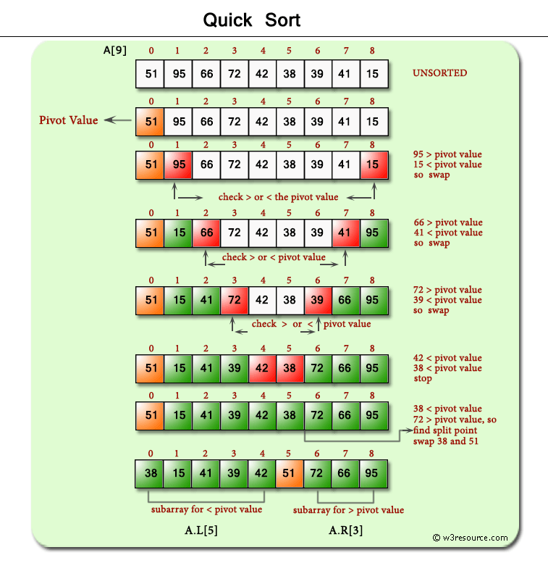

Slide 36
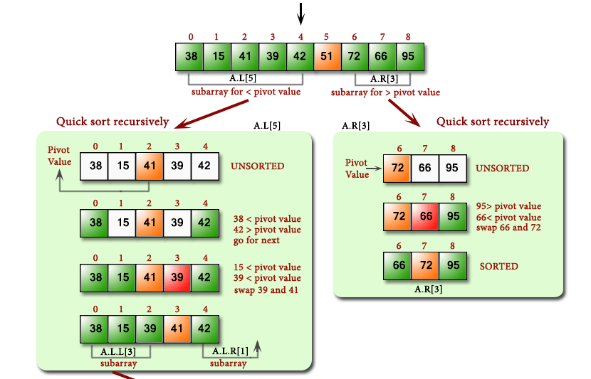

Slide 37
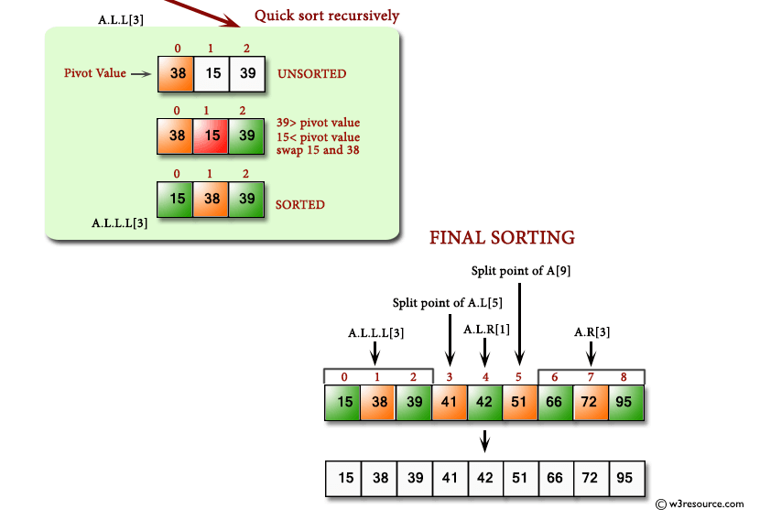

Slide 39
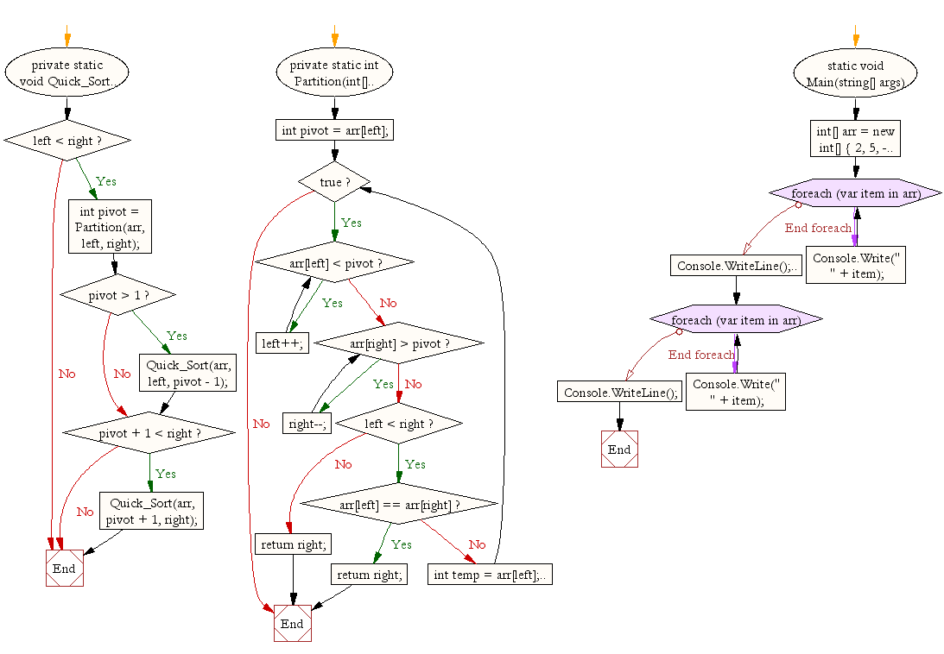

Slide 40
Quicksort Analysis
Assume that keys are random, uniformly distributed.
What is best case running time?

Slide 41
Quicksort Analysis
Assume that keys are random, uniformly distributed.
What is best case running time?
Recursion:
Partition splits array in two sub-arrays of size n/2
Quicksort each sub-array

Slide 42
Quicksort Analysis
Assume that keys are random, uniformly distributed.
What is best case running time?
Recursion:
Partition splits array in two sub-arrays of size n/2
Quicksort each sub-array
Depth of recursion tree?

Slide 43
Quicksort Analysis
Assume that keys are random, uniformly distributed.
What is best case running time?
Recursion:
Partition splits array in two sub-arrays of size n/2
Quicksort each sub-array
Depth of recursion tree? O(log₂n)

Slide 44
Quicksort Analysis
Assume that keys are random, uniformly distributed.
What is best case running time?
Recursion:
Partition splits array in two sub-arrays of size n/2
Quicksort each sub-array
Depth of recursion tree? O(log₂n)
Number of accesses in partition?

Slide 45
Quicksort Analysis
Assume that keys are random, uniformly distributed.
What is best case running time?
Recursion:
Partition splits array in two sub-arrays of size n/2
Quicksort each sub-array
Depth of recursion tree? O(log₂n)
Number of accesses in partition? O(n)

Slide 46
Quicksort Analysis
Assume that keys are random, uniformly distributed.
Best case running time: O(n log₂n)

Slide 47
Quicksort Analysis
Assume that keys are random, uniformly distributed.
Best case running time: O(n log₂n)
Worst case running time?

Slide 48
Quicksort: Worst Case
Assume first element is chosen as pivot.
Assume we get array that is already in order:
pivot_index = 0
2
4
10
12
13
50
57
63
100
[0] [1] [2] [3] [4] [5] [6] [7] [8]
too_big_index
too_small_index

Slide 49
While data[too_big_index] <= data[pivot]
++too_big_index
While data[too_small_index] > data[pivot]
--too_small_index
If too_big_index < too_small_index
swap data[too_big_index] and data[too_small_index]
While too_small_index > too_big_index, go to 1.
Swap data[too_small_index] and data[pivot_index]
pivot_index = 0
2
4
10
12
13
50
57
63
100
[0] [1] [2] [3] [4] [5] [6] [7] [8]
too_big_index
too_small_index

Slide 50
While data[too_big_index] <= data[pivot]
++too_big_index
While data[too_small_index] > data[pivot]
--too_small_index
If too_big_index < too_small_index
swap data[too_big_index] and data[too_small_index]
While too_small_index > too_big_index, go to 1.
Swap data[too_small_index] and data[pivot_index]
pivot_index = 0
2
4
10
12
13
50
57
63
100
[0] [1] [2] [3] [4] [5] [6] [7] [8]
too_big_index
too_small_index

Slide 51
While data[too_big_index] <= data[pivot]
++too_big_index
While data[too_small_index] > data[pivot]
--too_small_index
If too_big_index < too_small_index
swap data[too_big_index] and data[too_small_index]
While too_small_index > too_big_index, go to 1.
Swap data[too_small_index] and data[pivot_index]
pivot_index = 0
2
4
10
12
13
50
57
63
100
[0] [1] [2] [3] [4] [5] [6] [7] [8]
too_big_index
too_small_index

Slide 52
While data[too_big_index] <= data[pivot]
++too_big_index
While data[too_small_index] > data[pivot]
--too_small_index
If too_big_index < too_small_index
swap data[too_big_index] and data[too_small_index]
While too_small_index > too_big_index, go to 1.
Swap data[too_small_index] and data[pivot_index]
pivot_index = 0
2
4
10
12
13
50
57
63
100
[0] [1] [2] [3] [4] [5] [6] [7] [8]
too_big_index
too_small_index

Slide 53
While data[too_big_index] <= data[pivot]
++too_big_index
While data[too_small_index] > data[pivot]
--too_small_index
If too_big_index < too_small_index
swap data[too_big_index] and data[too_small_index]
While too_small_index > too_big_index, go to 1.
Swap data[too_small_index] and data[pivot_index]
pivot_index = 0
2
4
10
12
13
50
57
63
100
[0] [1] [2] [3] [4] [5] [6] [7] [8]
too_big_index
too_small_index

Slide 54
While data[too_big_index] <= data[pivot]
++too_big_index
While data[too_small_index] > data[pivot]
--too_small_index
If too_big_index < too_small_index
swap data[too_big_index] and data[too_small_index]
While too_small_index > too_big_index, go to 1.
Swap data[too_small_index] and data[pivot_index]
pivot_index = 0
2
4
10
12
13
50
57
63
100
[0] [1] [2] [3] [4] [5] [6] [7] [8]
too_big_index
too_small_index

Slide 55
While data[too_big_index] <= data[pivot]
++too_big_index
While data[too_small_index] > data[pivot]
--too_small_index
If too_big_index < too_small_index
swap data[too_big_index] and data[too_small_index]
While too_small_index > too_big_index, go to 1.
Swap data[too_small_index] and data[pivot_index]
pivot_index = 0
2
4
10
12
13
50
57
63
100
[0] [1] [2] [3] [4] [5] [6] [7] [8]
<= data[pivot]
> data[pivot]

Slide 56
Quicksort Analysis
Assume that keys are random, uniformly distributed.
Best case running time: O(n log₂n)
Worst case running time?
Recursion:
Partition splits array in two sub-arrays:
one sub-array of size 0
the other sub-array of size n-1
Quicksort each sub-array
Depth of recursion tree?

Slide 57
Quicksort Analysis
Assume that keys are random, uniformly distributed.
Best case running time: O(n log₂n)
Worst case running time?
Recursion:
Partition splits array in two sub-arrays:
one sub-array of size 0
the other sub-array of size n-1
Quicksort each sub-array
Depth of recursion tree? O(n)

Slide 58
Quicksort Analysis
Assume that keys are random, uniformly distributed.
Best case running time: O(n log₂n)
Worst case running time?
Recursion:
Partition splits array in two sub-arrays:
one sub-array of size 0
the other sub-array of size n-1
Quicksort each sub-array
Depth of recursion tree? O(n)
Number of accesses per partition?

Slide 59
Quicksort Analysis
Assume that keys are random, uniformly distributed.
Best case running time: O(n log₂n)
Worst case running time?
Recursion:
Partition splits array in two sub-arrays:
one sub-array of size 0
the other sub-array of size n-1
Quicksort each sub-array
Depth of recursion tree? O(n)
Number of accesses per partition? O(n)

Slide 60
Quicksort Analysis
Assume that keys are random, uniformly distributed.
Best case running time: O(n log₂n)
Worst case running time: O(n²)!!!

Slide 61
Quicksort Analysis
Assume that keys are random, uniformly distributed.
Best case running time: O(n log₂n)
Worst case running time: O(n²)!!!
What can we do to avoid worst case?

Slide 62
Improved Pivot Selection
Pick median value of three elements from data array:
data[0], data[n/2], and data[n-1].
Use this median of the array
Partitioning always cuts the array into roughly half
An optimal quicksort (O(N log N))
However, hard to find the exact median

Slide 63
Improving Performance of Quicksort
Improved selection of pivot.
For sub-arrays of size 3 or less, apply brute force search:
Sub-array of size 1: trivial
Sub-array of size 2:
if(data[first] > data[second]) swap them
Sub-array of size 3?

Slide 64
Pivot: median of three
We will use median of three
Compare just three elements: the leftmost, rightmost and center
Swap these elements if necessary so that
A[left] = Smallest
A[right] = Largest
A[center] = Median of three
Pick A[center] as the pivot
Swap A[center] and A[right – 1] so that pivot is at second last position
median3

Slide 65
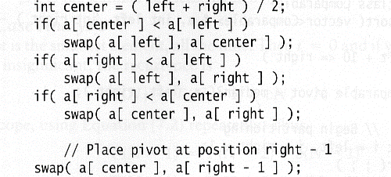
Pivot: median of three
Code for partitioning with median of three pivot:

Slide 66
Pivot: median of three
2
5
6
4
13
3
12
19
6
A[left] = 2, A[center] = 13, A[right] = 6
2
5
6
4
6
3
12
19
13
Swap A[center] and A[right]
2
5
6
4
6
3
12
19
13
Choose A[center] as pivot
pivot
2
5
6
4
19
3
12
6
13
Swap pivot and A[right – 1]
pivot
Note we only need to partition A[left + 1, …, right – 2]

Slide 67
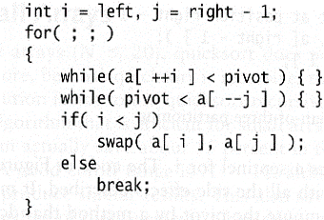
Implementation of partitioning step
Works only if pivot is picked as median-of-three.
A[left] <= pivot and A[right] >= pivot
Thus, only need to partition A[left + 1, …, right – 2]
j will not run past the end
because a[left] <= pivot
i will not run past the end
because a[right-1] = pivot

Slide 68
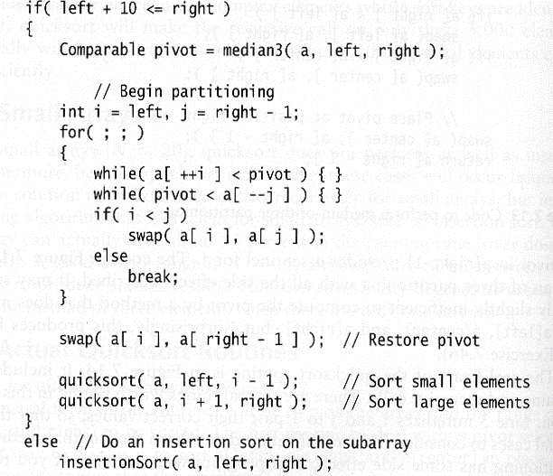
Main Quicksort Routine
Choose pivot
Partitioning
Recursion
For small arrays

Slide 69
Quicksort Faster than Mergesort
Both quicksort and mergesort take O(N log N) in the average case.
Why is quicksort faster than mergesort?
The inner loop consists of an increment/decrement (by 1, which is fast), a test and a jump.
Mergesort involves a large number of data movements.
Quicksort is done in-place.

Slide 70
Performance of quicksort
Worst-case: takes O(n2) time.
Average-case: takes O(n log n) time.
On typical inputs, quicksort runs faster than other algorithms.

Slide 71
Further Analysis of Quicksort
The analysis is quite tricky.
Assume all the input elements are distinct
no duplicate values makes this code faster!
there are better partitioning algorithms when duplicate input elements exist (e.g. Hoare's original code)
Let T(n) = worst-case running time on an array of n elements.

Slide 72
Worst-case of quicksort
QUICKSORT runs very slowly when its input array is already sorted (or is reverse sorted).
almost sorted data is quite common in the real-world
This is caused by the partition using the min (or max) element which means that one side of the partition will have has no elements. Therefore:
T(n) = T(0) +T(n-1) + Θ(n)
= Θ(1) +T(n-1) + Θ(n)
= T(n-1) + Θ(n)
= Θ(n²) (arithmetic series)
no elements
n-1 elements

Slide 73
Worst-case recursion tree
T(n) = T(0) +T(n-1) + cn

Slide 74
Worst-case recursion tree
T(n) = T(0) +T(n-1) + cn
T(n)

Slide 75
Worst-case recursion tree
T(n) = T(0) +T(n-1) + cn
cn
T(0) T(n-1)

Slide 76
Worst-case recursion tree
T(n) = T(0) +T(n-1) + cn
cn
T(0) c(n-1)
T(0) T(n-2)

Slide 77
Worst-case recursion tree
T(n) = T(0) +T(n-1) + cn
cn
T(0) c(n-1)
T(0) T(n-2)
T(0)
Θ(1)

Slide 78
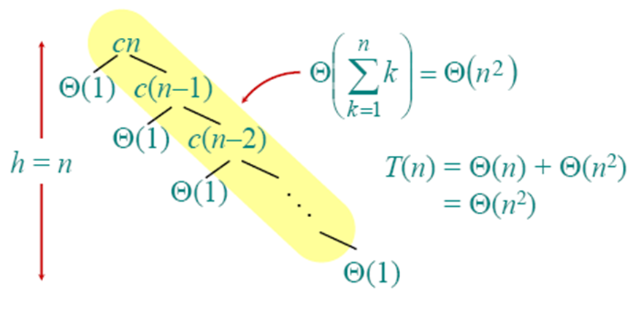
Worst-case recursion tree
T(n) = T(0) +T(n-1) + cn

Slide 79
Quicksort isn't Quick?
In the worst case, quicksort isn't any quicker than insertion sort.
So why bother with quicksort?
It's average case running time is very good, as we'll see.

Slide 80
Best-case Analysis
If we’re lucky, PARTITION splits the array evenly:
T(n) = 2T(n/2) + Θ(n)
= Θ(n log n) (same as merge sort)
Case 2 of the
Master Method

Slide 81
Almost Best-case
What if the split is always 1/10 : 9/10?
T(n) = T(1/10n) + T(9/10n) + Θ(n)

Slide 82
Analysis of “almost-best” case
T(n)

Slide 83
Analysis of “almost-best” case
cn
T(1/10n) T(9/10n)

Slide 84
Analysis of “almost-best” case
cn
T(1/10n) T(9/10n)
T(1/100n ) T(9/100n) T(9/100n) T(81/100n)

Slide 85
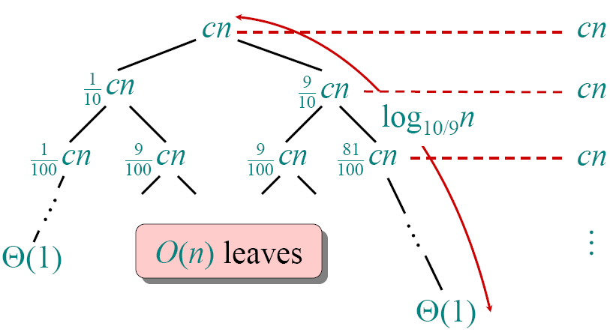
Analysis of “almost-best” case

Slide 86
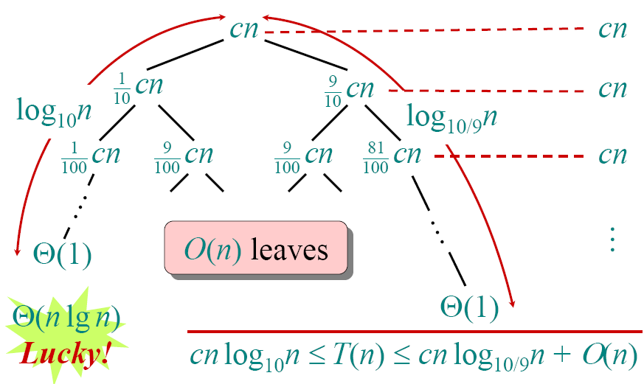
Analysis of “almost-best” case

Slide 87
Short and Long Path Heights
Short path node value: n → (1/10)n → (1/10)²n → ... → 1
∴ n(1/10)^{sp} = 1
∴ n = 10^{sp} // take logs
∴ log₁₀n = sp
Long path node value: n → (9/10)n → (9/10)²n → ... → 1
∴ n(9/10)^{lp} = 1
∴ n = (10/9)^{lp} // take logs
∴ log_{10/9}n = lp

Slide 88
Quicksort in Practice
Quicksort is a great general-purpose sorting algorithm.
especially with a randomized pivot
Quicksort can benefit substantially from code tuning
Quicksort can be over twice as fast as merge sort
Quicksort behaves well even with caching and virtual memory.

Slide 89
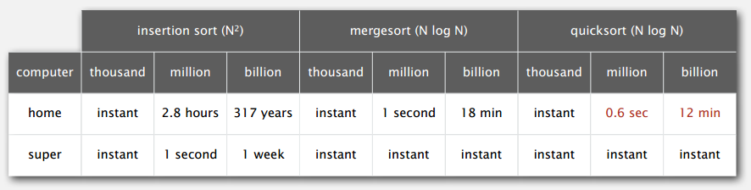
Timing Comparisons
Lesson 1. Good algorithms are better than supercomputers.
Lesson 2. Great algorithms are better than good ones.
Running time estimates:
Home PC executes 10⁸ compares/second.
Supercomputer executes 10¹² compares/second

Slide 90
Quickselect
Quickselect algorithm is used to find the i-th smallest element in a given unordered array
Randomized algorithm using divide and conquer
Similar to randomized quicksort
Like quicksort: Partitions input array recursively
Unlike quicksort: Makes a single recursive call
Reminder: Quicksort makes two recursive calls
Expected runtime: Θ(n)
Reminder: Expected runtime of quicksort: Θ(nlgn)

Slide 91
Selection in Expected Linear Time: Example 1
Select the 2nd smallest element:
i = 2
Partition the input array:
6 | 10 | 13 | 5 | 8 | 3 | 2 | 11
2 | 3 | 5 | 13 | 8 | 10 | 6 | 11
make a recursive call to select the 2nd smallest element in left subarray

Slide 92
Selection in Expected Linear Time: Example 2
Select the 7th smallest element:
i = 7
Partition the input array:
6 | 10 | 13 | 5 | 8 | 3 | 2 | 11
2 | 3 | 5 | 13 | 8 | 10 | 6 | 11
make a recursive call to select the 4th smallest element in right subarray

Slide 93
Selection in Expected Linear Time
R-SELECT(A,p,r,i)
if p = r then return A[p]
q ← R-PARTITION(A, p, r)
k ← q–p+1 if i ≤ k then
return R-SELECT(A, p, q, i)
else
return R-SELECT(A, q+1, r, i-k)
≤ x (k smallest elements)
≥ x
x = pivot
p q
r

Slide 94
Selection in Expected Linear Time
p q r
≤ x
≥ x
x = pivot
L
R
All elements in L ≤ all elements in R
L contains |L| = q–p+1 = k smallest elements of A[p...r] if i ≤ |L| = k then
search L recursively for its i-th smallest element else
search R recursively for its (i-k)-th smallest element

Slide 95



Runtime Analysis
Worst case:
Imbalanced partitioning at every level
and the recursive call always to the larger partition
i=8
recursive call
1 | 2 | 3 | 4 | 5 | 6 | 7 | 8
2 3
4
5
6
7
8
i=7
recursive call

Slide 96
Runtime Analysis
Worst case:
T(n) = T(n-1) + Θ(n)
➔ T(n) = Θ(n²)
Worse than the naïve method (based on sorting)
Best case: Balanced partitioning at every recursive level
T(n) = T(n/2) + Θ(n)
➔ T(n) = Θ(n)
Avg case: Expected runtime – need analysis

